Slide 1
Key takeaways
September 2019

Slide 2
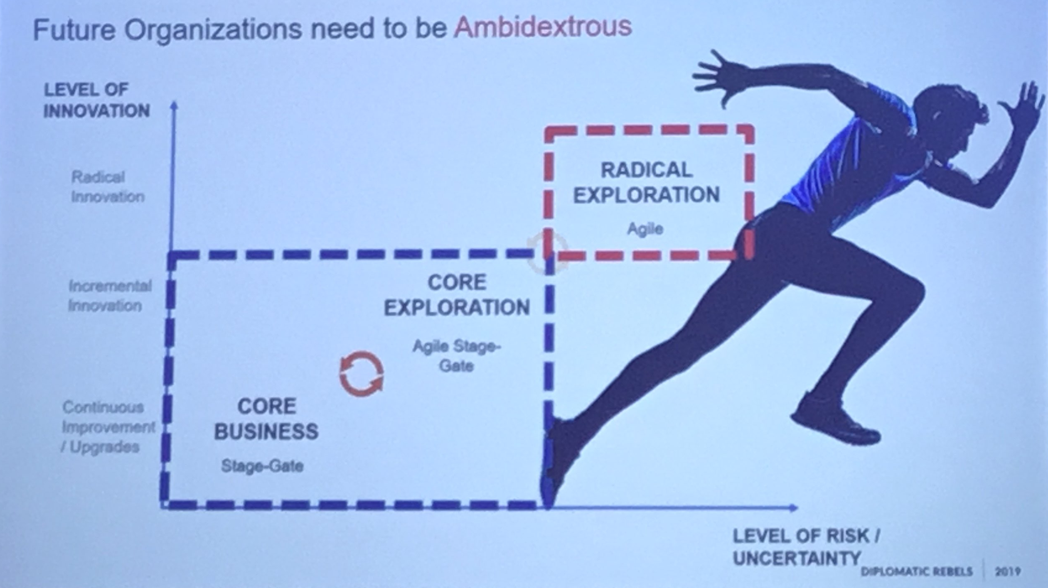
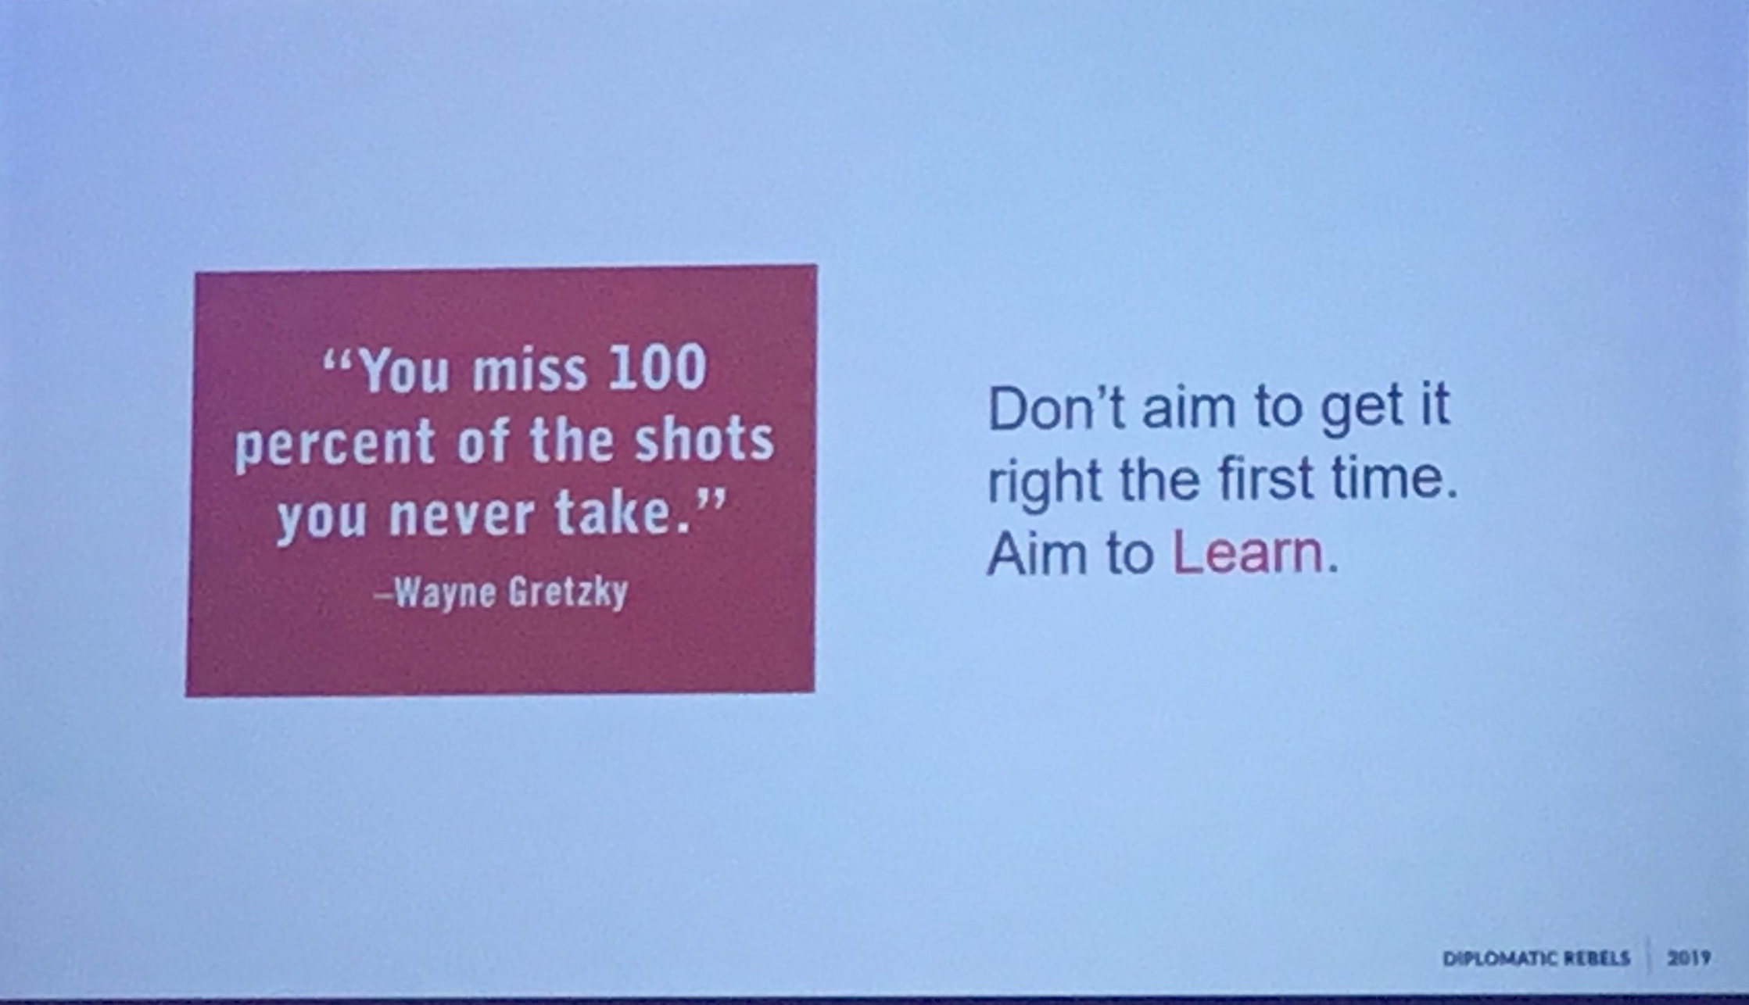
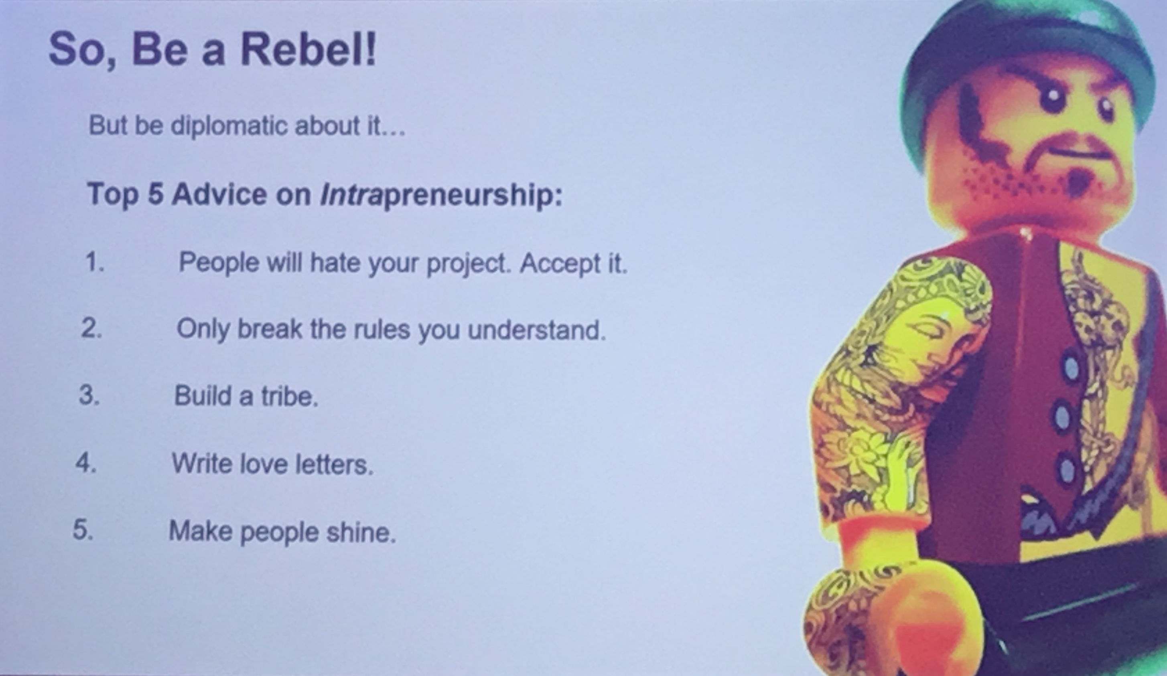
Try radical innovation through intrapreneurship
David Gram (Lego)
Intrapreneurship is the opposite of innovation theatre.
Structured organisational innovation is great PR but doesn't actually change anything.
Intrapreneurship is about building stuff, doing things and exploring the future.
https://diplomaticrebels.com/

Slide 3
Be a bold digital leader
Natalie Taylor (PA Consulting)
1/6 of organisations will become obsolete in 5 years - you must adapt or die
Others have done it and it works. Amazon vs the high street. Uber vs taxis
Those who master digital can flip markets overnight
Grapple with the Digital Talent Challenge
All sectors are struggling to hire the right people and have no confidence in HR
Remove bias in hiring and develop a senior leadership team that can cope with the digital future - or fire them all
Digital isn't a thing anymore. It’s fast becoming part of our businesses and households
Learn Lessons From Digital-First Firms
ASOS has the same goals as Topshop but goes about it in a completely different way
Copy what works for other digital first firms
Embrace an experimental mindset
Try something new, something different or better. Do it today. It may not be right first time but we can learn
It will come down to your bold digital leadership that will enable change
the only wrong answer is to stand still

Slide 4
Embrace A Positive Human Future
Frazer Bennett (PA Consulting)
Too many organisations are organised around targets and tasks which means we loose flexibility
We celebrate small successes and miss the bigger picture
There are new forces at play and you must exploit them to make the most of this opportunity
The four forces:
Respect for social change
Transparency and trust
Difference over Conformity
Harness technologies for all
We have brilliant people, we have technologies that empower, we have that innate sense of purpose. But this is not a tweak it is a radical rethink of how we operate and organise.
Try these four things:
Everything has a silver lining. Nurture human optimism
Empower teams to innovate
Build evolving organisations
Seek inspiration in surprising places. Embrace not invented here

Slide 5
the UK’s Top 3 most disruptive companies
D/sruption 50
https://appyway.com/ An app to solve the urban parking problem
https://what3words.com Describe any location across the globe with just three words
https://olioex.com/ A food sharing platform

